Slide 1
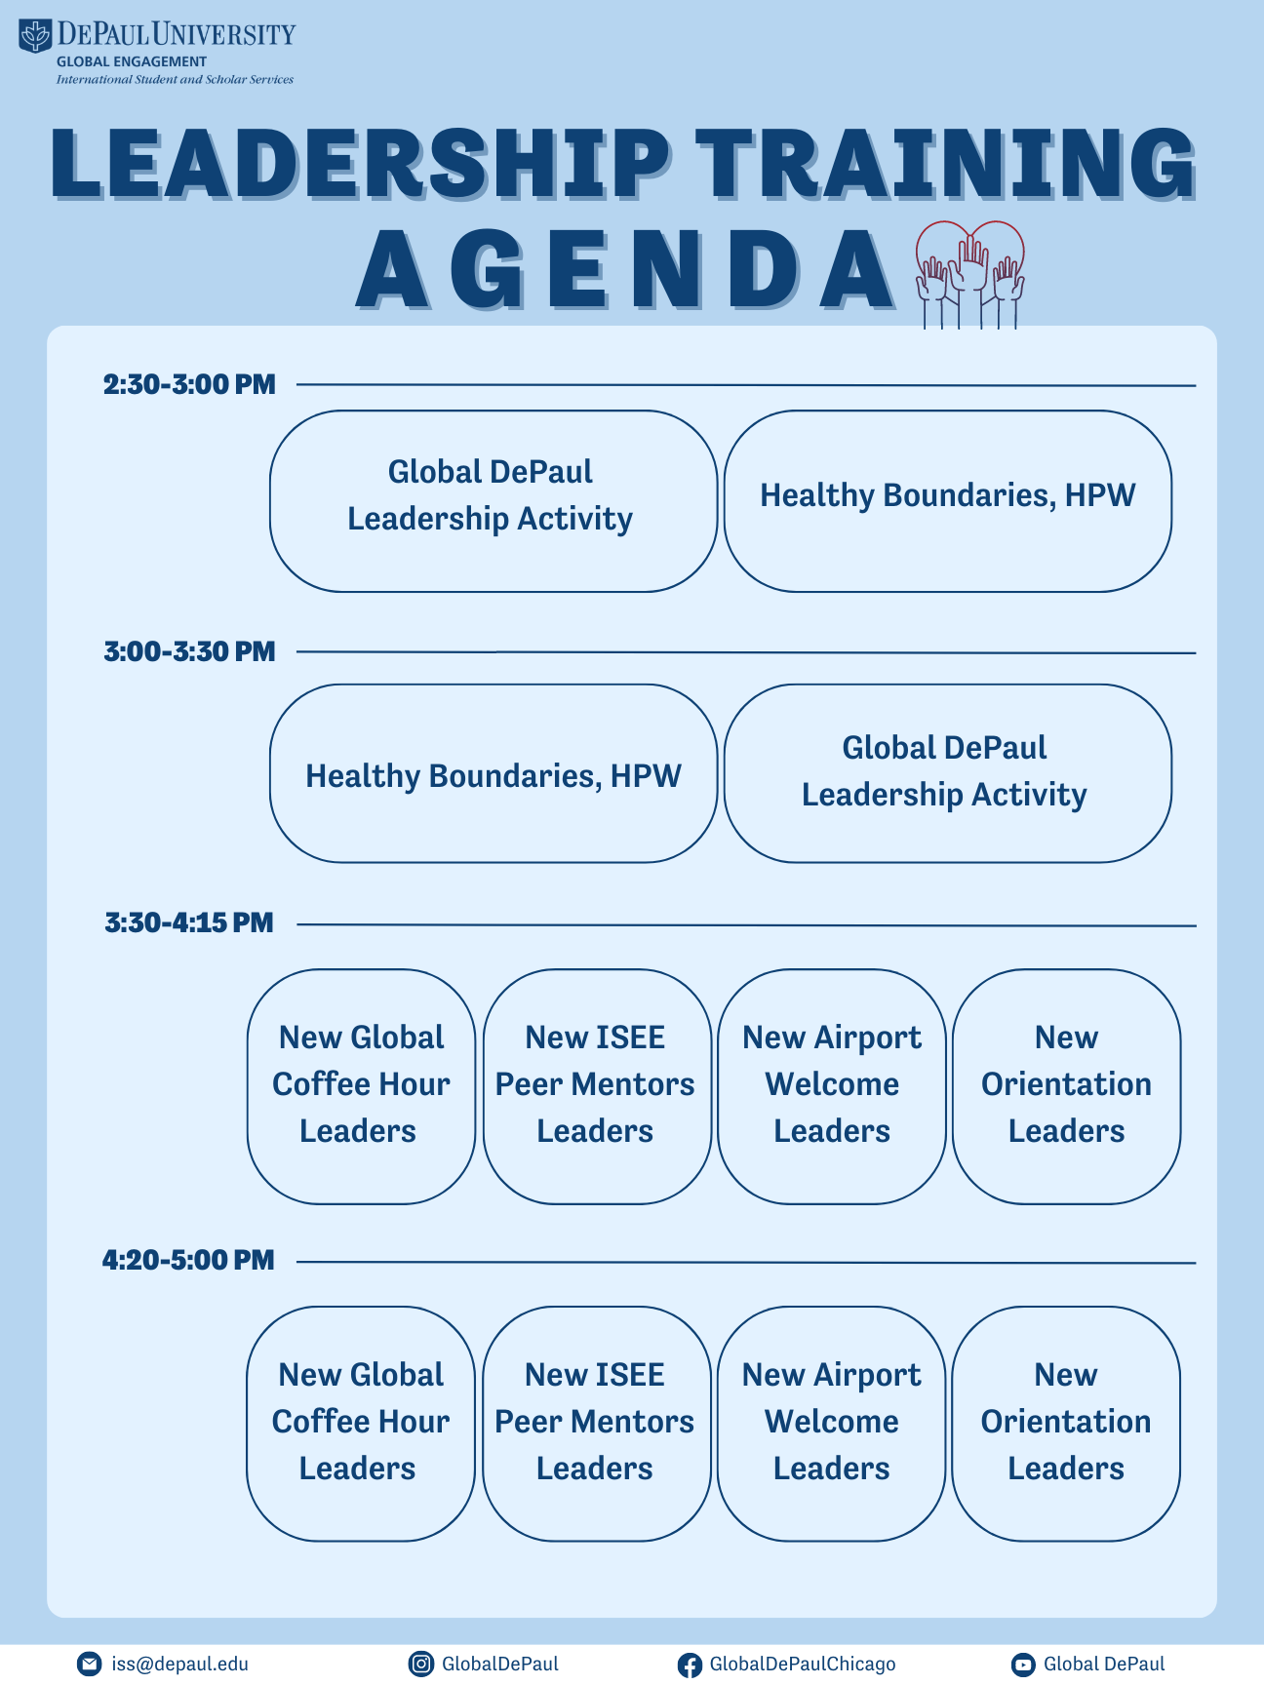
TRAINING TODAY

